Slide 1
Phase Transitions in AI
Irina Rish
Notes:
Capturing the entropy of all of natural language

Slide 2
Examples
3SAT, CSP
Random graphs
Universal Laws of Robustness (Madry’s “phase transition)
GPT-3 accuracy on Arithmetic task - GPT-3
Grokking

Slide 3
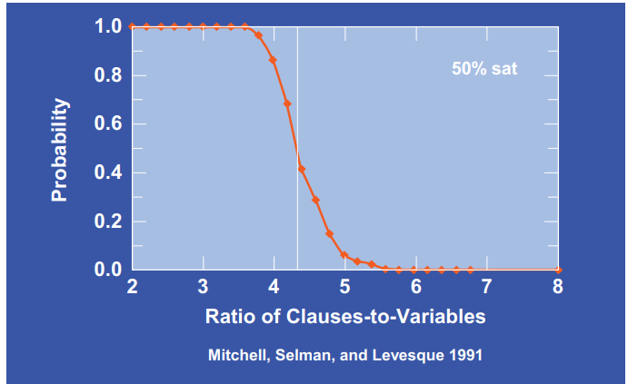
Phase Transitions in 3SAT (and other CSPs)

Slide 4

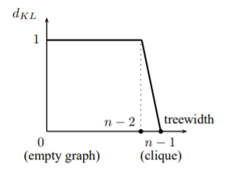
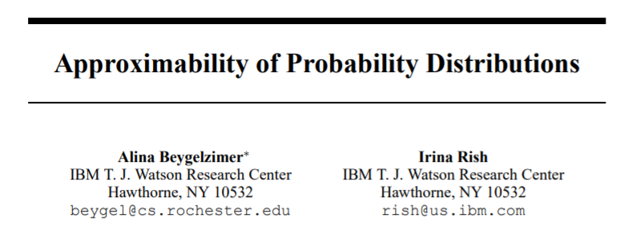
Phase Transitions Random Graphs
The theory of random graphs was initiated by Erdos and Renyi [7], and one of the main observations they made was that many natural monotone properties appear rather suddenly, i.e., as we increase p(edge), there is a sharp transition from a property being very unlikely to it being very likely. Friedgut [8] proved that every monotone graph property of undirected graphs has such a threshold behavior.
NIPS 2003

Slide 5
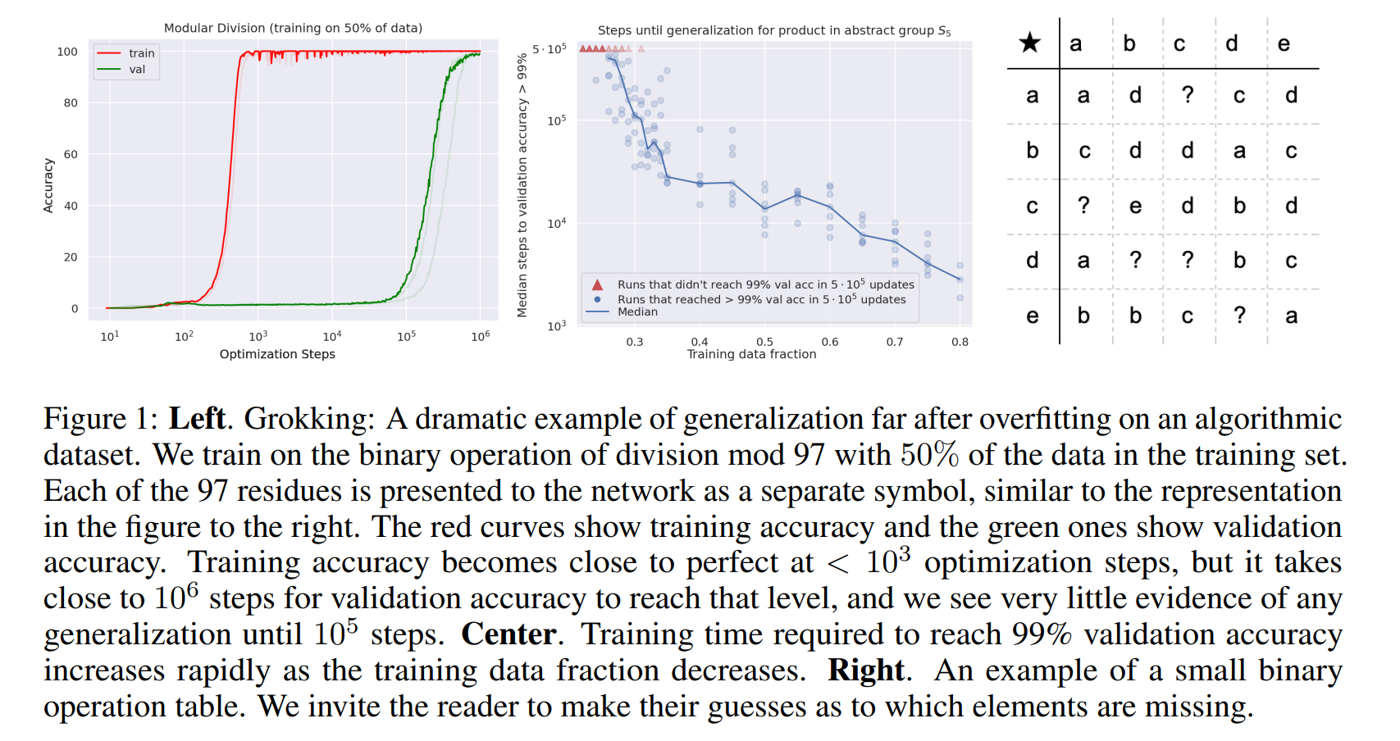
“Phase Transitions” in Accuracy (Grokking)
with Increase in Compute and Data

Slide 6
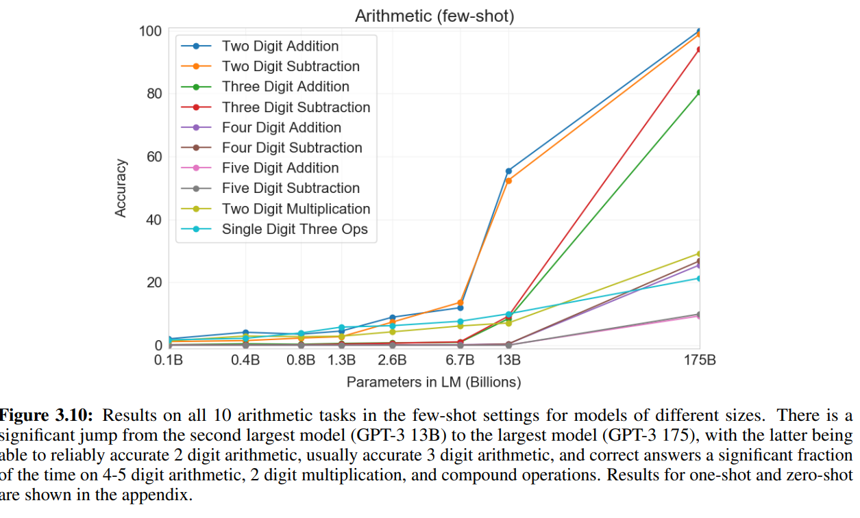
“Phase Transitions” in GPT-3 Performance with Number of Parameters

Slide 7
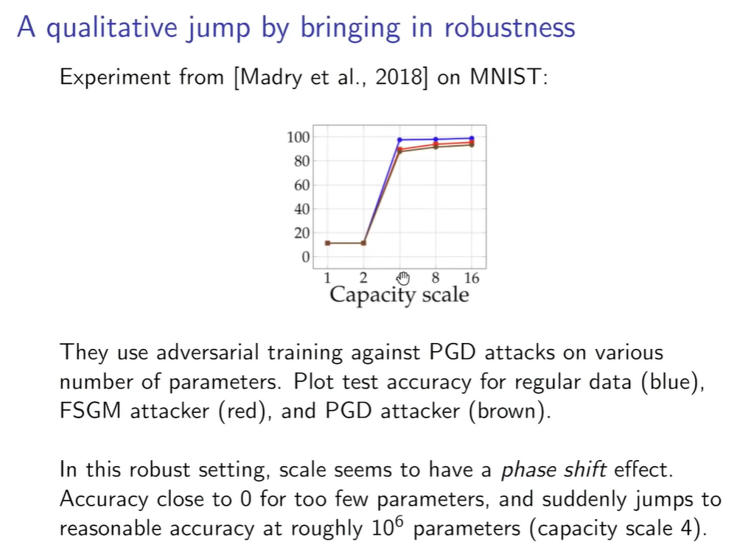

Slide 8
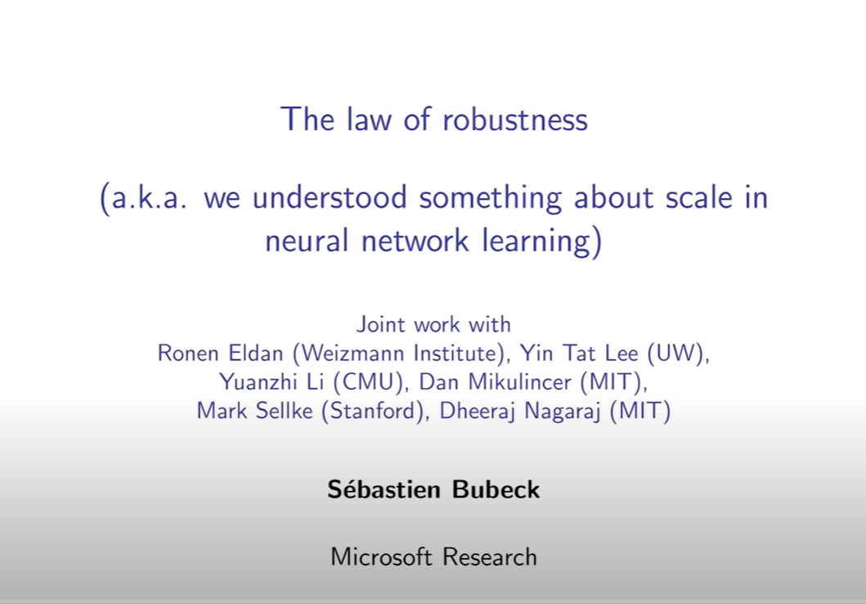
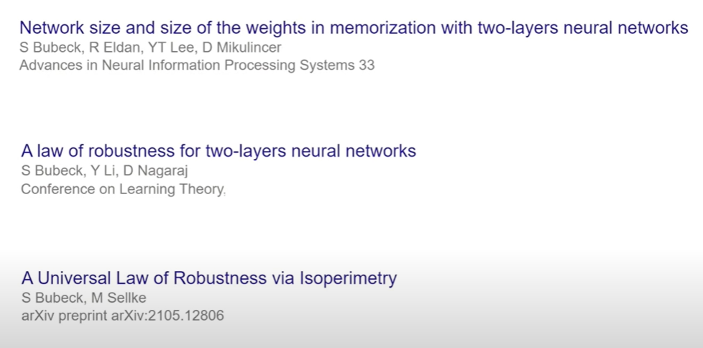
https://www.youtube.com/watch?v=OzGguadEHOU

Slide 9
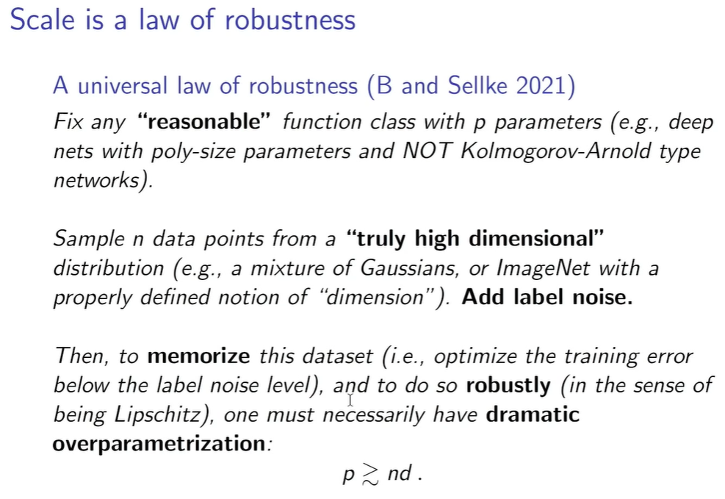

Slide 10
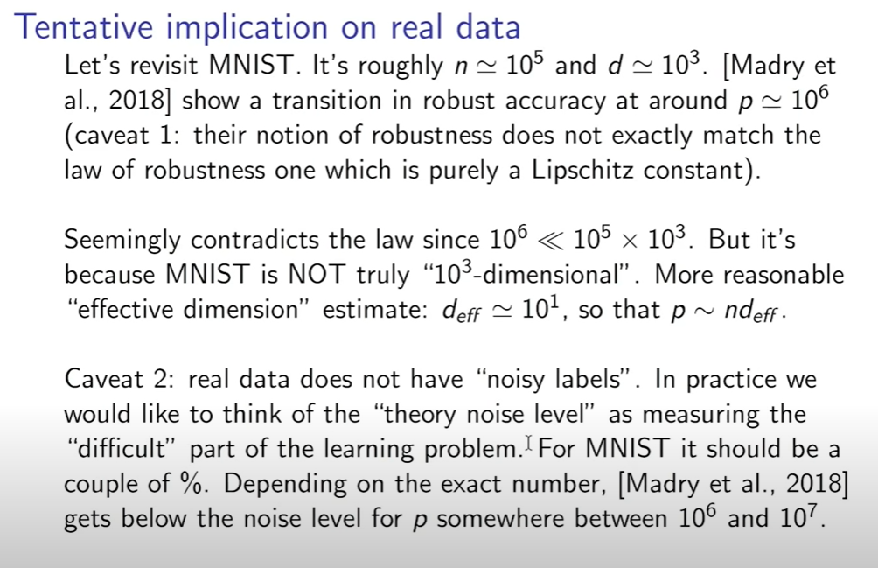

Slide 11
